Slide 1
Multidimensional Data Analysis
From: GradQuant
Host: Michael Remington (He/Him)

Slide 2


Slide 3
Table of Contents
Definitions and Background
Exploratory Data Analysis (EDA)
Principal Component Analysis
Cluster Analysis
Multidimensional Linear Models

Slide 4
Table of Contents
Definitions and Background
Exploratory Data Analysis (EDA)
Principal Component Analysis
Cluster Analysis
Multidimensional Linear Models

Slide 5
Go to Python Script

Slide 6
Table of Contents
Definitions and Background
Exploratory Data Analysis (EDA)
Principal Component Analysis
Cluster Analysis
Multidimensional Linear Models

Slide 7
What is Principle Component Analysis?
PCA: An algorithm that reduces the dimensionality of high dimensional vector space.
Lay terms: Distils lots of information from many different variables into a few variables called ‘Principal Components’
If you know linear algebra we are reducing vectors down to their eigen vectors and eigen values
Python PCA (Principal Component Analysis) with Sklearn - DataCamp

Slide 8
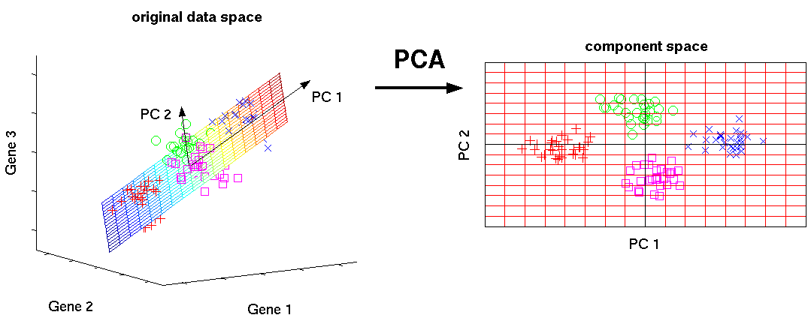
machine learning - *Why* are eigenvectors the principal components in Principal Component Analysis? - Cross Validated (stackexchange.com)

Slide 9
Loading Scores
Loading scores is a metric which is a link between vectors on the principle component analysis and the original. It explains how variables explain the variance of the principal components.
Loading scores range from -1 and 1. Variables with a larger absolute magnitude loading score explain contribute more to the specific PC new geometry.
1 means the variables presence contributes to the structure of the principal component.
-1 means the absence of the vector is what is causing this new geometry.
Understanding Scores and Loadings • LearnPCA (bryanhanson.github.io)

Slide 10
Table of Contents
Definitions and Background
Introductory Visualizations
Principal Component Analysis
Cluster Analysis
Multidimensional Linear Models

Slide 11
Clustering Algorithms
Why cluster data?
New knowledge of the domain
Could be useful to have algorithmically categorized groups
3 types of clustering
Partition Clustering
Hierarchical Clustering
Density Based Clustering
K-Means Clustering in Python: A Practical Guide – Real Python

Slide 12
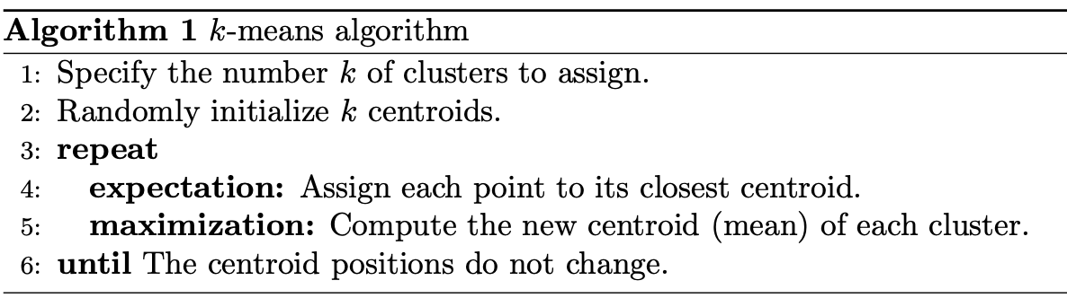
K-Means Clustering
Partition Clustering Algorithm
K-Means Clustering in Python: A Practical Guide – Real Python

Slide 13
Table of Contents
Definitions and Background
Exploratory Data Analysis (EDA)
Principal Component Analysis
Cluster Analysis
Multidimensional Linear Models

Slide 14
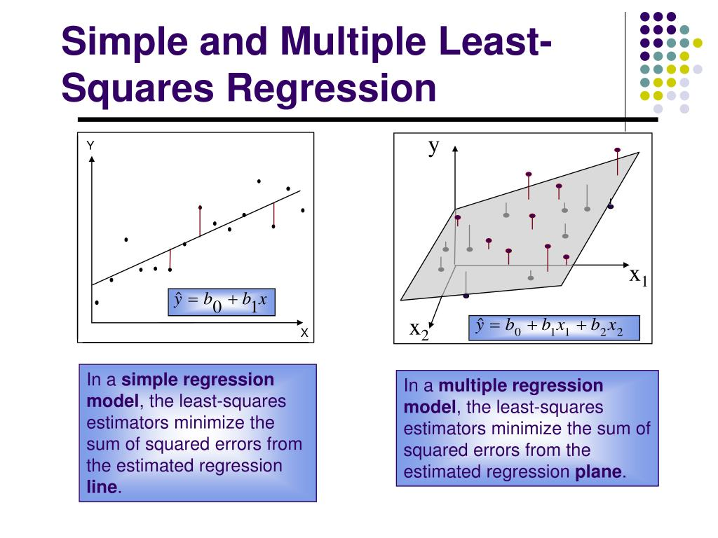
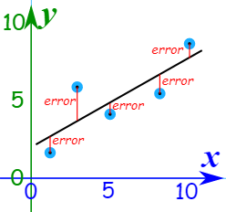
Multi Dimensional Regression
Y_{hat}=B₁ x₁ + B₂x₂ …. + B₀
Least Squares Regression (mathsisfun.com)
PPT - Regression Analysis and Multiple Regression PowerPoint Presentation - ID:6143176 (slideserve.com)

